Slide 1
Fast Background Subtraction
Rohit Kumar

Slide 2
Overview
Problem statement
Literature Survey
Our Work
Future scope and conclusion

Slide 3
Problem statement

Slide 4
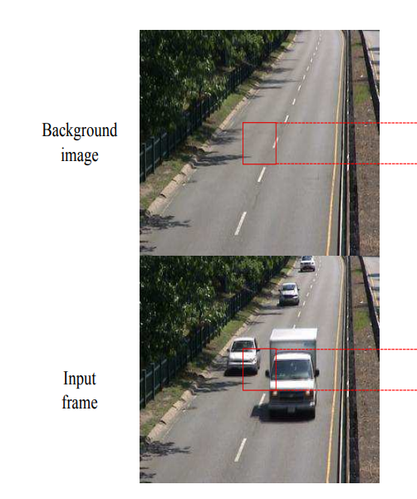
Data view
Consider the camera mounted at the security gate.
We have a static image i.e the image to be considered as background.
We have frames having object coming and going.

Slide 5
What is background subtraction ?
Foreground detection is one of the major tasks in the field of computer vision and image processing whose aim is to detect changes in image sequences.
Background subtraction is any technique which allows an image's foreground to be extracted for further processing (object recognition etc.).
Background subtraction is a widely used approach for detecting moving objects in videos from static cameras.
As a preprocessing step of object detection
Surveillance tracking
Human pose estimation etc.

Slide 6
Task
Task is to develop a deep learning model that do the background subtraction.
In addition considering the constraints
BGS is a preprocessing step in real application systems.
It is inherent need of systems for it to be fast.
It should not be specific to a scene. Generalisation is needed.
Run nearly 200 fps with a batch of 10.

Slide 7
Challenges to consider
Model should be robust to
Illumination Changes - even in static scenes, lightning changes is a problem.
Camouflage - similar colors of background and foreground
Night videos - As most pixels have a similar color in a night scene, recognition of foreground objects and their contours is difficult
Hard Shadows - Dark, moving shadows that do not fall under the illumination change category
We need not to worry about :
Dynamic background - not applicable for the case of static scenes
Camera Jitter
Ghost/ Intermittent Object motion - Foreground objects that are embedded into the background scene and start moving after background initialization are the so-called ghosts.

Slide 8
Literature Survey

Slide 9
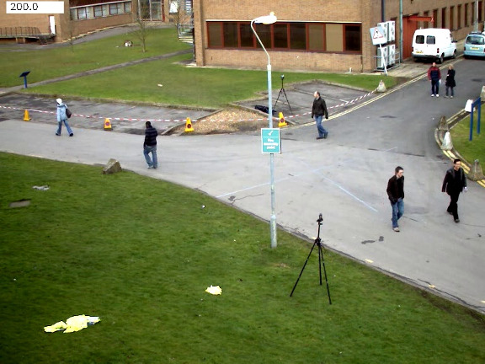
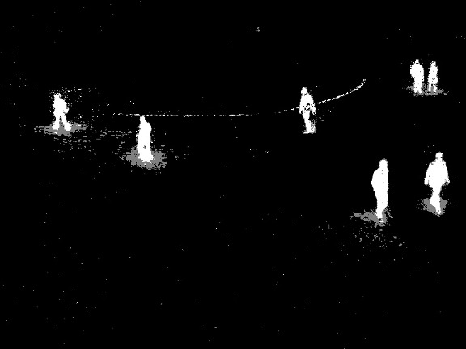
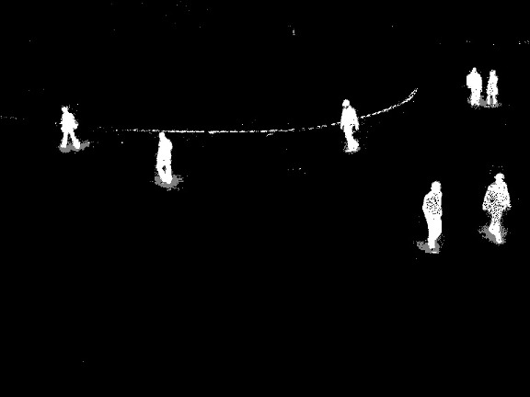
Classical methods
There are classic algorithms like MOG, MOG2, KNN etc. are simple threshold based.
They do not address
Camouflage
illumination changes
Night videos and other challenges
MOG
KNN

Slide 10
State of the art
FgSegNet and FgSegNet2 are on the top of CDNet benchmark.
They are are deep neural networks not ready for deployment in real-time.
Others
Paper : A Deep Convolutional Neural Network for Background Subtraction
Proposes a lightweight CNN model but
Scene specific
Patch based approach
Input size dependant
Paper : BSUV-Net: A Fully-Convolutional Neural Network for Background Subtraction of Unseen Videos
Too deep to be applicable for real-time preprocessing step.

Slide 11
The limitations of classical methods and complexity of challenges pushes us to use CNN based models.
Our need for a model that generalises for any { background, input_Image } pair.

Slide 12
Our work

Slide 13
Datasets
Human activities
There are nearly 31 datasets available for background subtraction divided into three categories
Article
Conference
Project
A list of those can be found here
CDNet is the most complete dataset as per our needs.

Slide 14
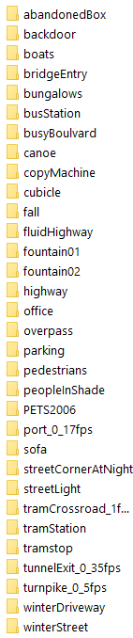
CD-Net
Change detection dataset
Dataset is of video frames
Each frame is labelled by foreground mask.
After filtering for our target we got these subsets.
Total image ~48,000
Dataset
Test set - [ sofa, pedestrians ] ~3,500 images
Train set - [ all except the test set folders ] ~ 44,500 images

Slide 15
Background subtraction
Background subtraction has the following steps
Background modeling
Background initialization
Background maintenance
Foreground detection

Slide 16
BS : Background modeling & initialization
Taking mean of first 10 frames proves to be sufficient model for initial background.
For each sub - dataset
Generate a BG_IMAGE as mean of the first 10 frames.

Slide 17
BS : Background Maintenance
Since our target does not include modelling { dynamic background, camera jitter, and intermittent object motion } background maintenance is not required for our task.
We assume that initial background created will remain same
However, the illumination changes, which are natural even for static backgrounds are induced as a preprocessing step.

Slide 18
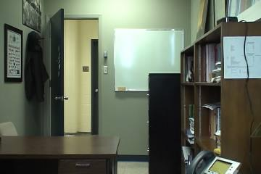
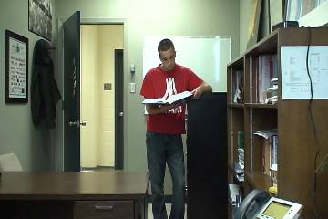

BS : Foreground Detection
Overview
Background image
Algorithm
Predicted Mask
Preprocessing
A 6 channel input
Input frame
True Output Mask
Loss
Optimisation

Slide 19
Capturing challenges in data
Illumination Changes:
Adding a random illumination change in the preprocessing step.
Camouflage :
In dataset
Night videos :
In dataset
Hard Shadows :
In dataset

Slide 20
Preprocessing
Our model is size independent, however for training with batches
Random crop of size 224
Five types of labels in CDNet i.e each pixel in true mask is marked with one of the five.
0 : static
Background
50 : hard shadow
Background
85 : Outside ROI
170 : Unknown motion
Outside ROI
255 : Motion
Foreground
We don't train on the pixels that are outside ROI.

Slide 21
Preprocessing
Random illumination change.
Normalise the image to the range [ 0, 1 ].
Make the mask single channel and binary [ 0, 1 ] .
Include value 0.85 for outside ROI regions.

Slide 22
Model
A fully connected CNN ( FCNN ) model with 5 layers.
FCNN is important because we want our model to be independent of input size.
Kernel size : 3 with pad : 1 so that width and height remains same.
ReLU nonlinearity after Convolution
Batch Normalisation after non-linearity
Sigmoid after last layer to map the outputs to probability distribution for each pixel to be background or foreground.

Slide 23
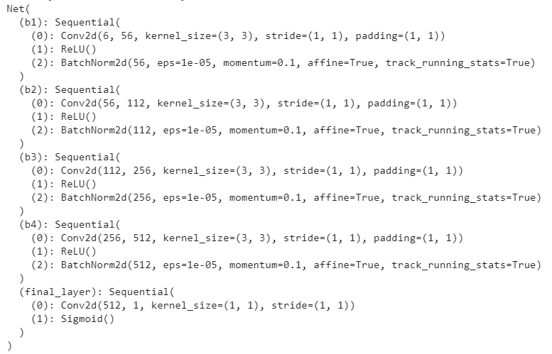
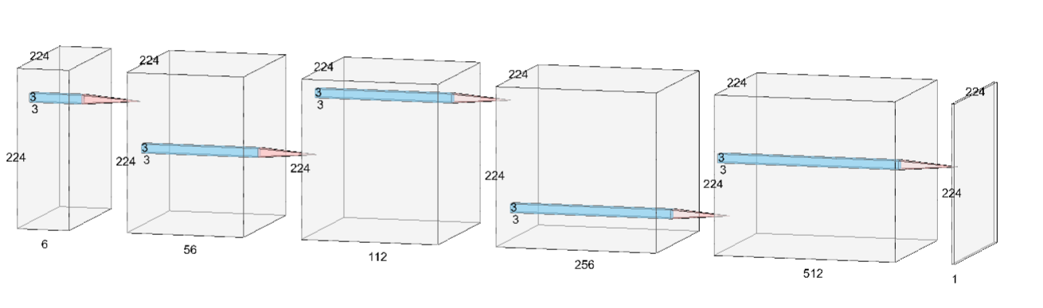
Algorithm

Slide 24
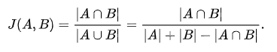
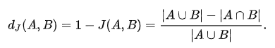
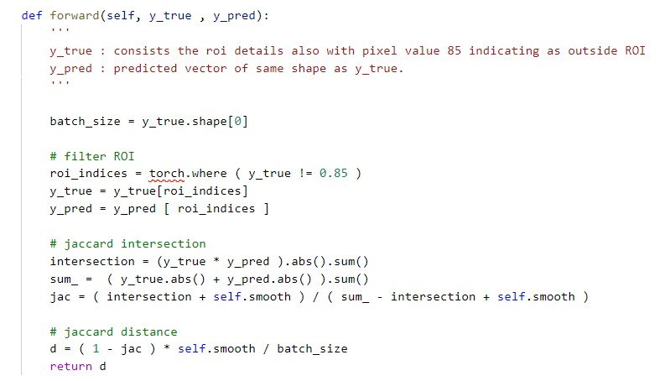
Jaccard Index
Loss function
Jaccard Distance
We used Jaccard distance as our loss measure.
We smoothed our loss to prevent loss decay to zero.
The pixels that are Outside ROI are not considered in loss and hence in training.

Slide 25
Optimizer
Adam with standard learning rate of 0.001.
optimizer = optim.Adam(net.parameters(),
lr=0.001,
betas=(0.9, 0.999),
eps=1e-08,
)

Slide 26
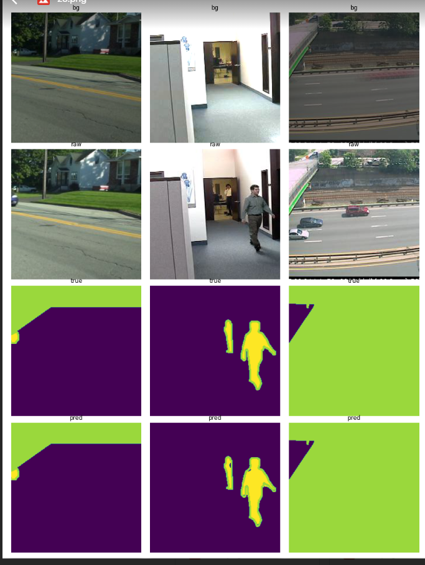
Results - Training

Slide 27
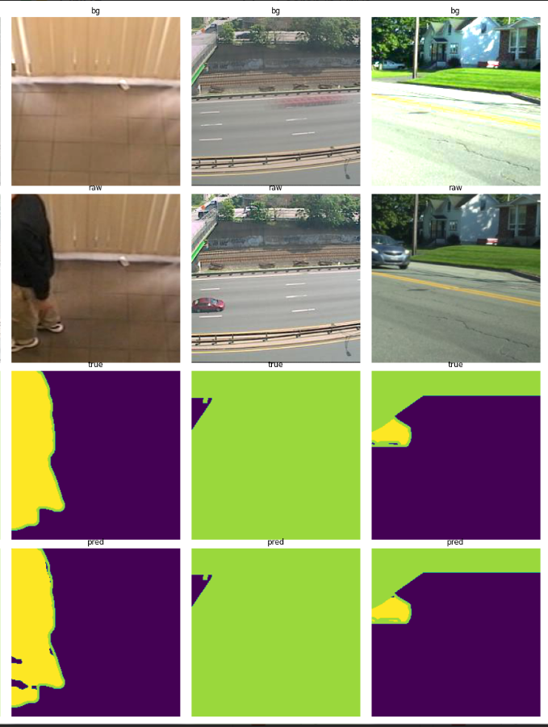
Results - Training

Slide 28
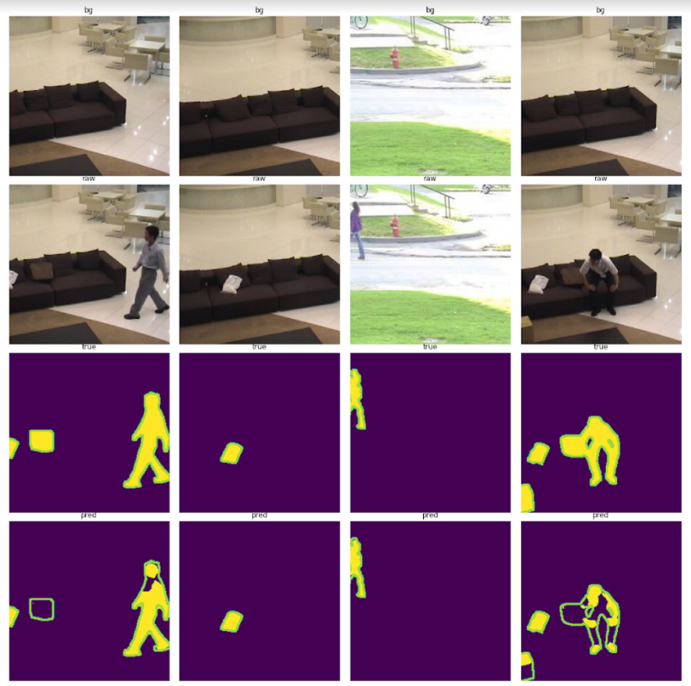
Results - Validation
Unable to capture camouflage
Able to capture good background

Slide 29
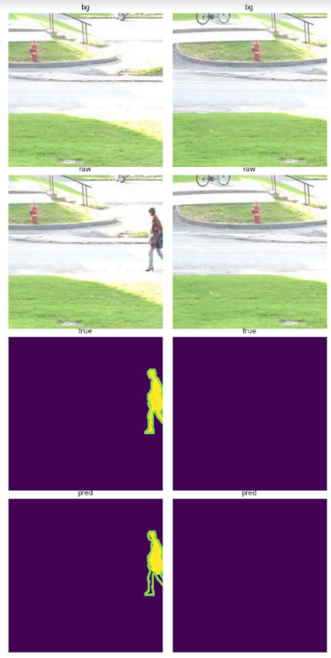
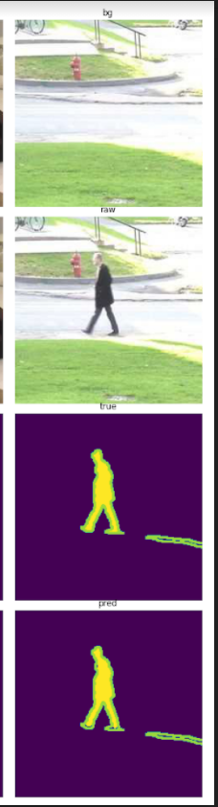
Results - Validation
Able to capture other than camouflage.

Slide 30
Insights
Dataset is not sufficient.
Plan
We need more dataset.
There are not much real datasets available for the task.
Since our target is similar to creating a general background and input frame comparator, we decided to create a synthetic dataset.

Slide 31
Insights
Camouflage is a difficult situation to capture.
Our dataset have few images to capture the pattern.
Plan
We need to ensure good amount of patterns related to camouflage in our synthetic dataset.

Slide 32
Insight
The whole training was done on Google Colab, while reading data from Google Drive storage.
Each iteration takes ~2hrs
I trained for ~30 epochs with iterative improvement.
Plan
We need more and fast computing power.
A dedicated system or Cloud service.

Slide 33
Synthetic dataset
Take a good dataset like COCO.
Take two random image from COCO : R_IMG1 and R_IMG2
Take a random mask from CDNet : R_MASK
Use R_IMG2 as background.
Cut out the R_MASK from R_IMG2 and paste over background.
Target_input = R_MASK * R_IMG1 + ( 1 - R_MASK ) * R_IMG2
Now we have synthetic target_input, Background image and true mask.
We believe that this will improve our algorithm for general background subtraction.

Slide 34
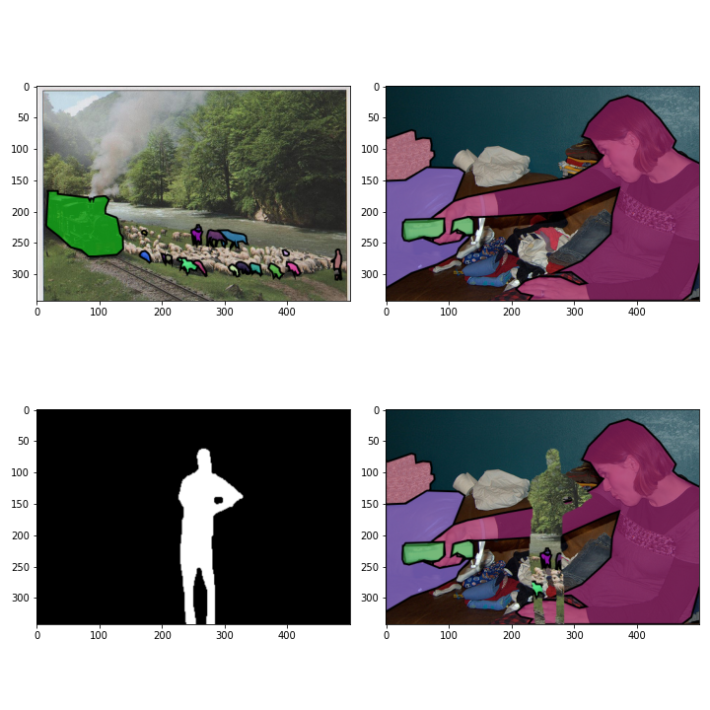
Please ignore the segmentation mask over the images.
This is due to web-viewer image in COCO are by default segmentation covered.
R_IMG1
R_IMG2
R_MASK
Target input

Slide 35
COCO dataset
We used COCO 2014
COCO train Images ~84K
COCO val images ~41k

Slide 36
Synthetic Dataset
Train size 200_000 random tuples of ( randomImage1, randomImage2 )
Validation size 5_000 random tuples of ( randomImage1, randomImage2)

Slide 37
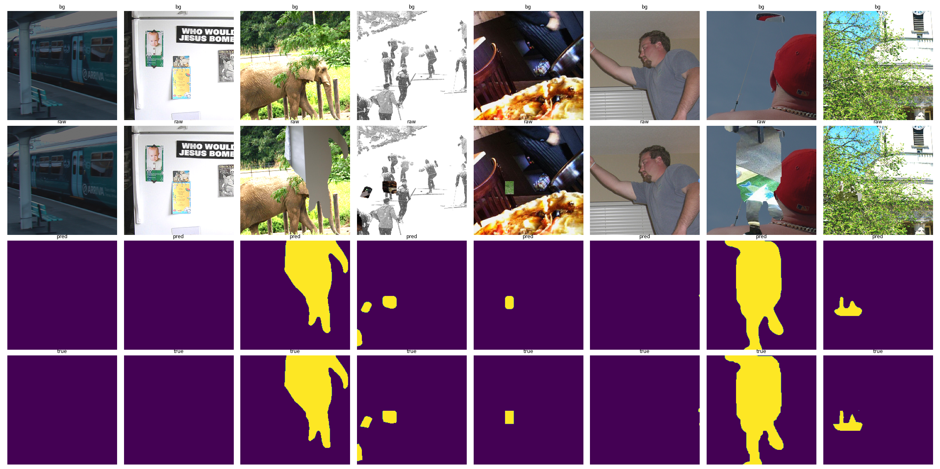
Training results on Results on Synthetic Data

Slide 38
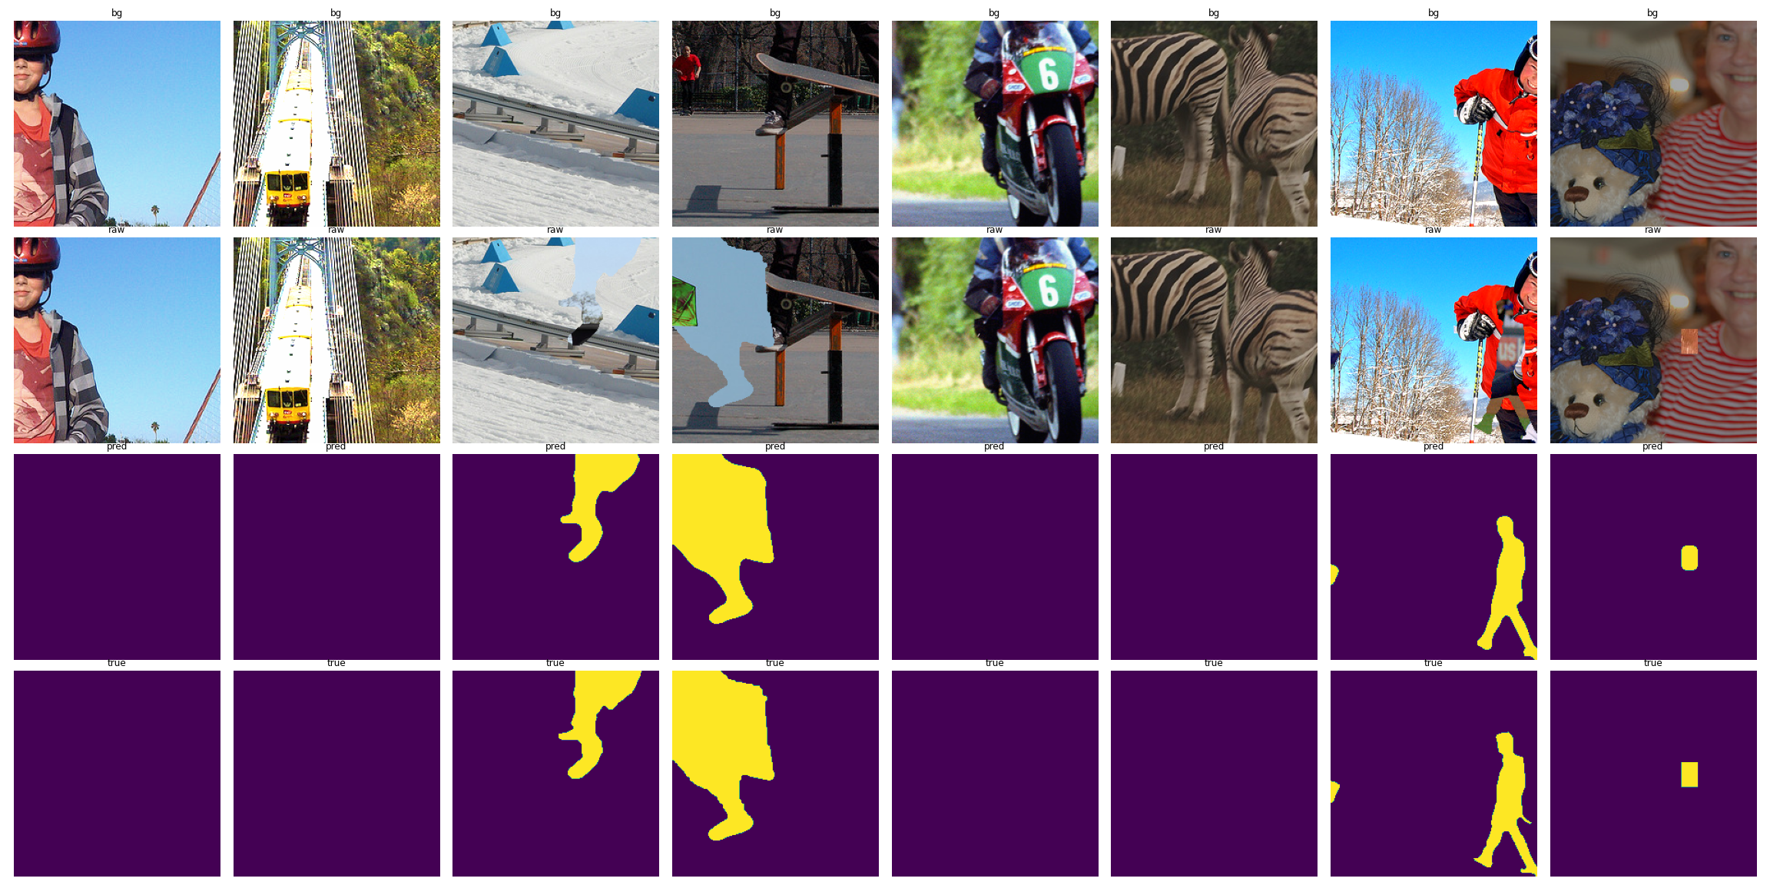
Training results on Results on Synthetic Data

Slide 39
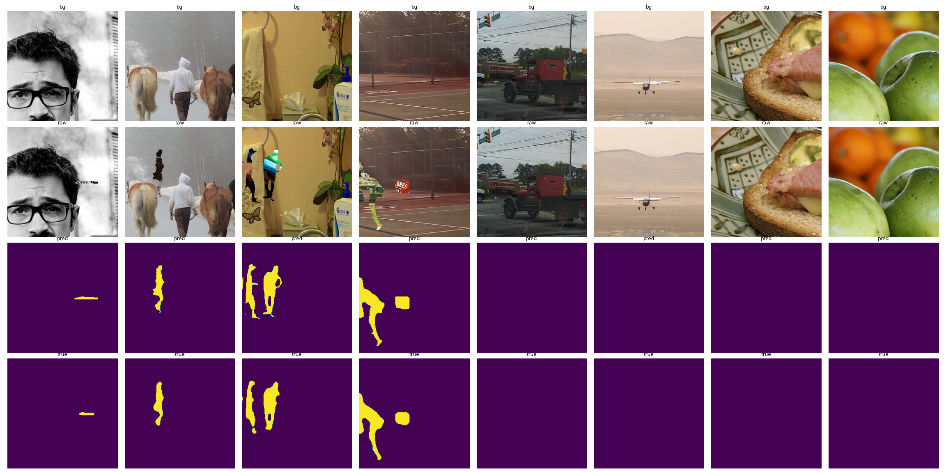
Validation results on Results on Synthetic Data

Slide 40
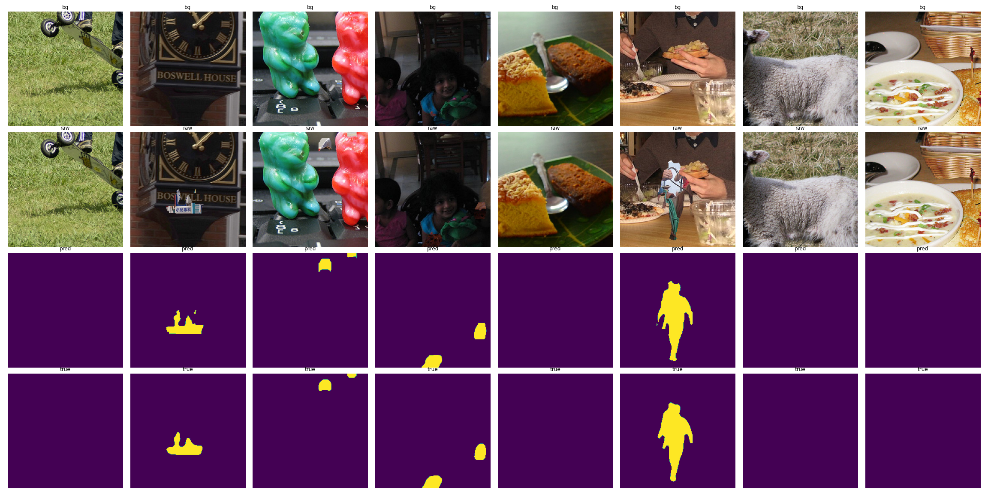
Validation results on Results on Synthetic Data

Slide 41
Future Scopes and Work

Slide 42
Dataset
Making it general and evaluating on real video frames.
Using more realistic masks and synthetic data
Masks of CDNet are not capturing all scenarios
Using masks from segmentation datasets like COCO.
Generate the dataset similar to previous methods.
Using computer graphics software to generate data specific to taks.
E.g generating background subtraction for human for video conferencing.
It’s easy to get multi-view perspectives of the person.
Thus enabling us to add generalisation in the BGS in view of camera position.

Slide 43
Application
Developing an application model that can use it.

Slide 44
Thankyou

